Slide 1
AGENDA
Introduction to Data Structures
Complexity Analysis
Arrays

Slide 2
INTRODUCTION
What are data structures ?
Data structures are the ways of organizing and storing data in a computer so that we can perform several operations efficiently on it. It is widely used in every aspect of computer science.

Slide 3
Real – time application of Data Structures
To store the contacts on our phone, the software simply place all our contacts in an array.
Web pages can be accessed using the previous and the next URL links which are linked using linked list.
The music players also use the same technique to switch between music.
Message logs and all messages you get are arranged in stack.
GPS navigation system also uses shortest path APIs.

Slide 4
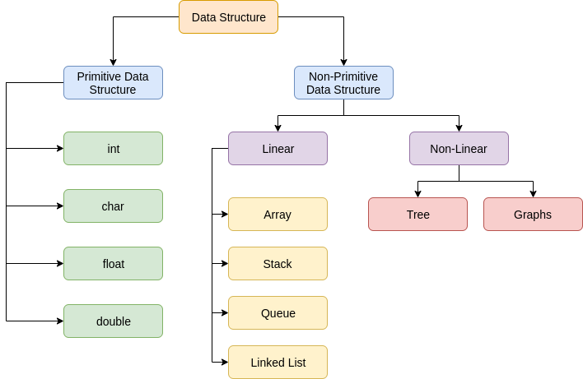
TYPES OF DATA STRUCTURE

Slide 5
Primitive Data Structures :
These are the predefined way of storing data in the system. All sets of operations are pre-defined. Char, int, float, double are examples of primitive data structures.
Non-Primitive Data Structures :
The data structures which are designed using primitive data structures are called non-primitive data structures. They are used to store a collection of data. It can be categorized into two parts:
1. Linear data structure
2. Non-Linear data structure

Slide 6
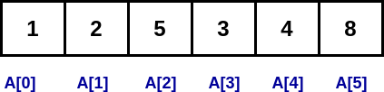
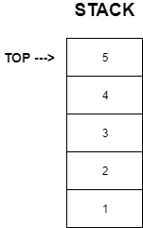
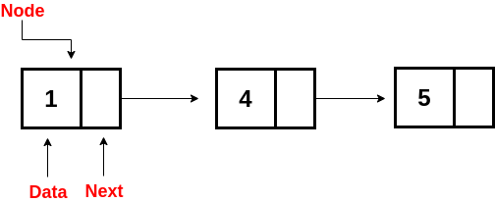
Linear Data Structures
Data structures in which elements are arranged sequentially or linearly and linked one after another are called linear data structures.
Examples: Array, Stack, Queues, Linked list.
ARRAY
LINKED LIST

Slide 7
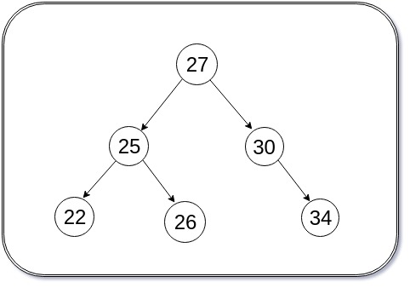
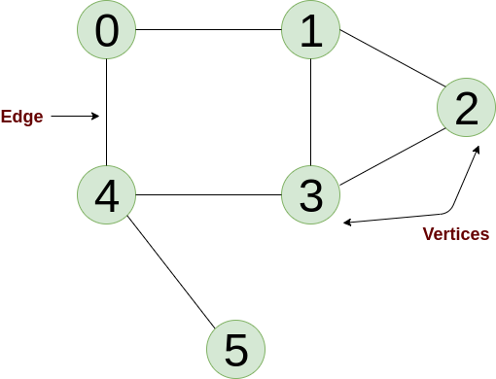
NON-LINEAR DATA STRUCTURE
Data structures in which elements are not arranged sequentially are called non-linear data structures.
Examples: Trees and Graphs.
GRAPH
TREE

Slide 8
Analysis of Algorithms
Given two algorithms for a task, how do we find out which one is better?

Slide 9
Asymptotic Analysis
In Asymptotic Analysis, we evaluate the performance of an algorithm in terms of input size. We calculate, how the time (or space) taken by an algorithm increases with the input size.
We can have three cases to analyze an algorithm:
1) The Worst Case
2) Average Case
3) Best Case

Slide 10
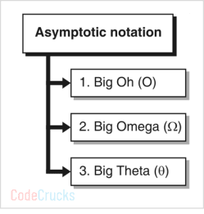
Big Oh represents upper bound.
2. Omega gives the lower bound.
3. Theta gives average case complexity.

Slide 11
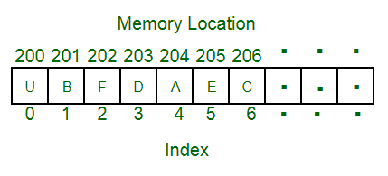
Arrays
An array is a collection of items stored at contiguous memory locations. The idea is to store multiple items of the same type together.

